Slide 1
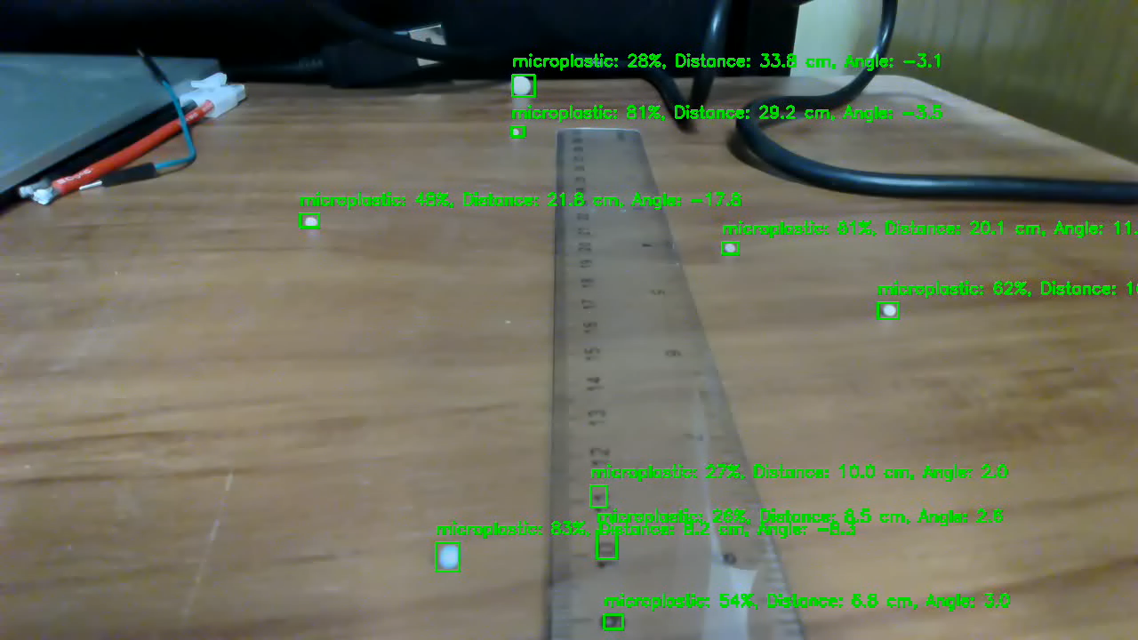

Slide 2

Single webcam
Still can fine-tune the numbers base on the setup.
It will be affected by wave.
Easy to setup and faster processing
I set the filter to remove duplicate detection

Slide 3
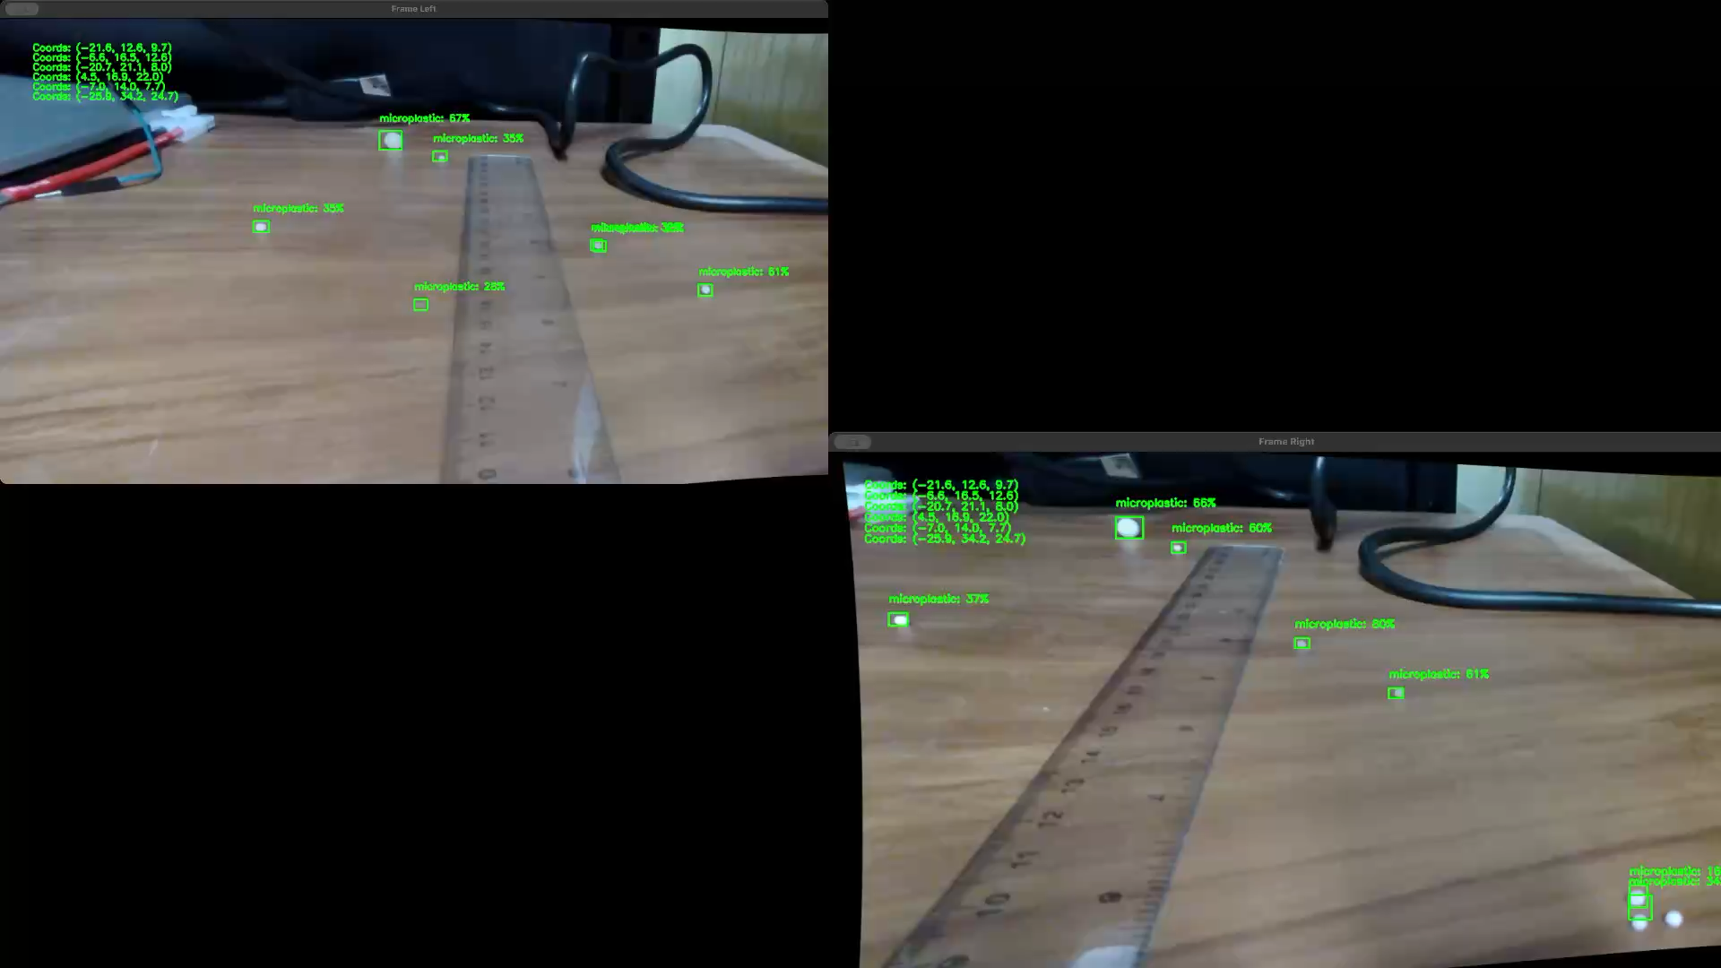

Slide 4
Two webcam
The main issue is that the frames they got are not identical even though they seem identical using our eyes. Therefore, the tiny difference would affect the tiny model.
According to the result, we can also use software to change the configuration of a webcam to get better performance, such as adjusting color or brightness
Even though it can get the z-axis. It still can be hard to get accurate coordinates due to the cost of performance.

